Slide 1
Batch : C1 1.Abhijit Pokharkar:12 2.Prashant Rathod:20 3.Nagesh Reure:22 4.Vivek Rugale:24 5.Pranjali Sagar:25
MEASUREMENT SYSTEMS AY 2020-21

Slide 2
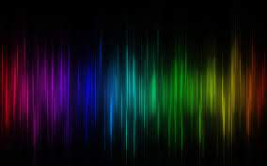
INFRARED SPECTROSCOPY AND ITS APPLICATIONS

Slide 3
CONTENT
What is IR spectroscopy and its region
Samples in IR spectroscopy
Vibrational modes
Principle of IR spectroscopy
IR spectroscopy instrumentation
Graph of IR spectrum
Techniques used for measurement of spectroscopy
1.Classical spectrophotometers
2.Fourier Transform spectrophotometers
Advantages & disadvantages of IR spectroscopy
Applications

Slide 4
About this template
What is IR Spectroscopy
Infrared spectroscopy: It is the measurement of the interaction of infrared radiation with matter by absorption, emission, or reflection
Use: To study and identify chemical substances or functional groups in solid, liquid, or gaseous forms
Basics of IR spectroscopy:
How IR spectrum is produced
IR spectrum
Unit of IR spectra
Instrument for measurement of IR spectrum

Slide 5
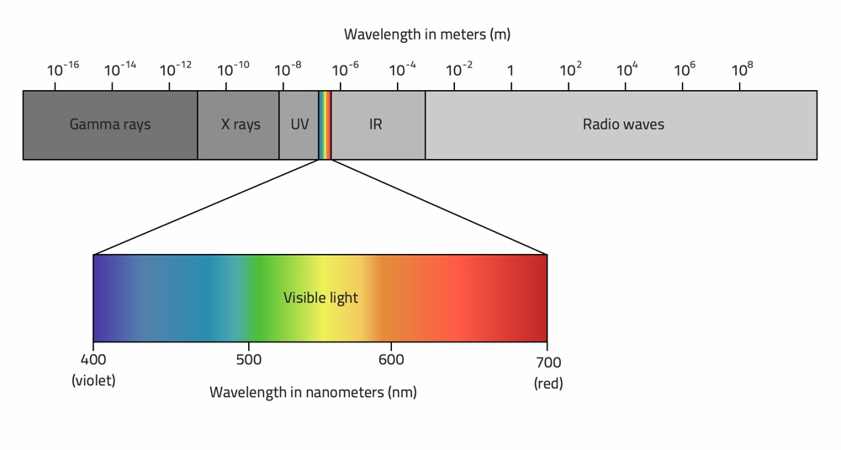
About this template
Region of IR Spectroscopy
Frequency range : 300 Ghz - 400 Thz
Near IR : 0.8 - 2.5 um
Mid IR : 2.5 - 25 um
Far IR : 25 - 1000 um

Slide 6
About this template
Samples in IR spectroscopy
Generally 4 techniques are employed for preparing Solid samples:
Solids run in solution.
Solid Films.
Mull technique.
Pressed pellet technique

Slide 7
Vibrational Modes
Stretching Vibrations
1. Symmetrical
2. Asymmetrical
Bending Vibrations
1. Scissoring
2. Wagging
3. Twisting
4. Rocking
Symmetric Stretch
Asymmetric Stretch
Scissoring
Wagging
Twisting
Rocking

Slide 8
You can also split your content
Principle of IR spectroscopy
1.Molecules are made up of the atoms linked by chemical bonds. The chemical bonds look like spring and balls (vibration).
2.This characteristic vibration are called natural frequency of vibration.
3. Applied infrared frequency = Natural frequency of Vibration.
4.change in dipole moment is required.

Slide 9
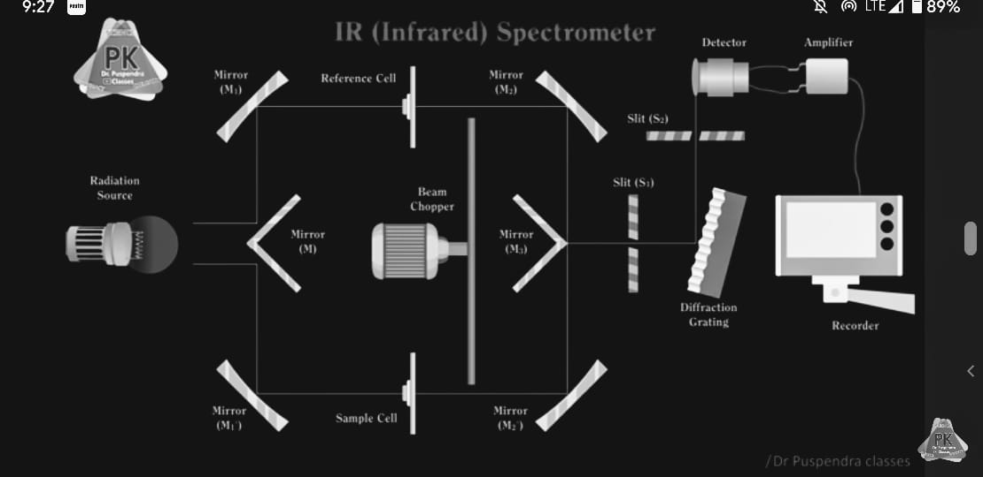
You can also split your content
IR spectroscopy instrumentation
Optical Components:
Light source
Sample holder
splitter
Diffraction grating
Detector
Amplifier
Recorder

Slide 10
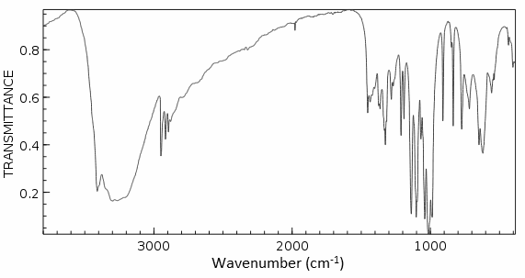
You can also split your content
Graph of IR Spectrum

Slide 11
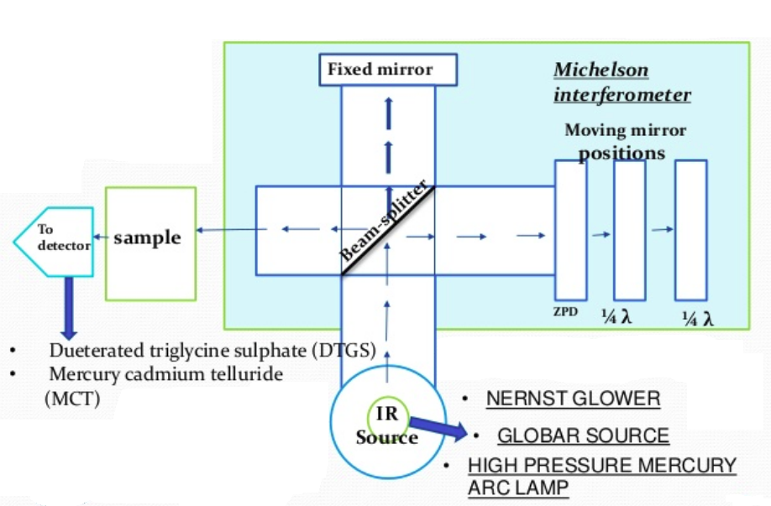
In two or three columns
Techniques of Infrared Spectroscopy
1.Classical Spectrophotometers
Dispersive IR spectrometer:
Radiations source
Sample/Reference paths
Grating
Entrance slit
Detector
2. Fourier Transform Spectrophotometers
Radiation Source
Interferometer
Detector

Slide 12
Advantages and disadvantages of IR spectroscopy
Advantages and disadvantages
Advantages
solids , liquids, gases, powders and polymers are all analyzed.
The peak positions , intensities widths and shapes all provide useful information.
fast and easy technique.
Disadvantages
Atoms or monatomic ions do not have infrared spectra.
Homonuclear diatomic molecules do not possess infrared spectra.
complex mixture and aqueous solutions are difficult to analyze infrared spectroscopy.

Slide 13
APPLICATIONS

Slide 14
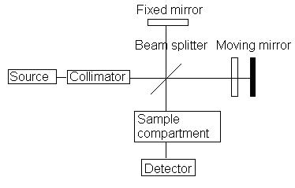
You can also split your content
APPLICATION 1
Analysis of artists’ pigments
The chemical identity of material used in art pieces is of key importance for their authentication and preservation
Key points:
Technique used: FTIR spectroscopy
measurements performed in: mid-IR region 4000-400 cm-1
Advantages of using this technique

Slide 15
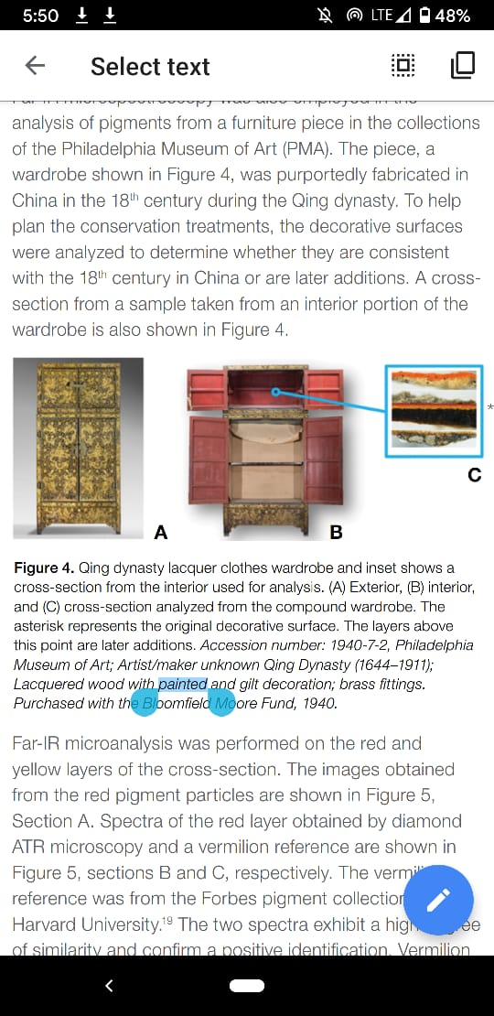
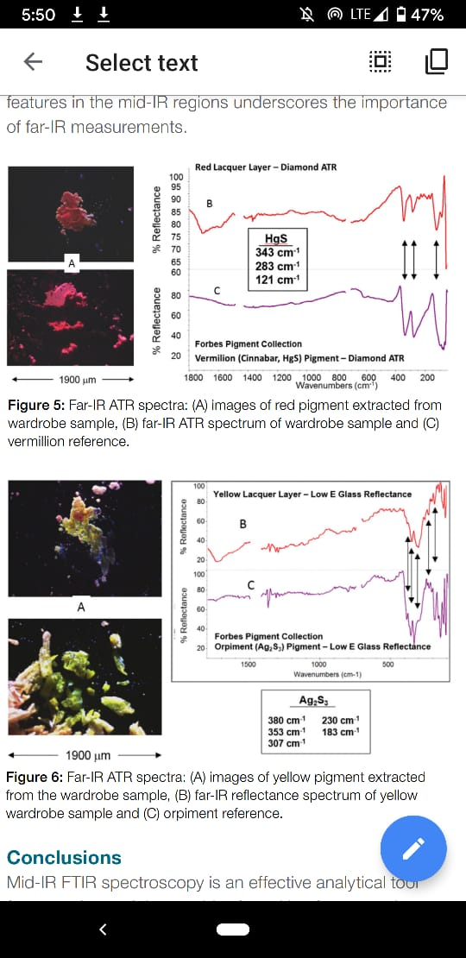
You can also split your content
APPLICATION 1
Analysis of artists’ pigments: Result and output
Yellow pigment identification
Red pigments identification
Art piece
This will help to detect fake masterpieces.

Slide 16
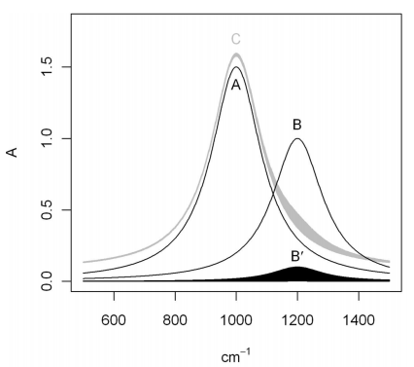
You can also split your content
APPLICATION 2
Detection of Impurities in organic and inorganic compounds
Near and Mid IR spectroscopy
Impurities cause deviation in the spectrum
Computer-aided comparison
Linear regression
FT-IR Spectrometer
[Ref: Fayaz Kondagula1 Karl Molt1 1 Fakultt fr Chemie, Universitt Duisburg-Essen, Duisburg, Germany - Infrared Spectrometric Purity Control of Organic Liquids and Water]

Slide 17
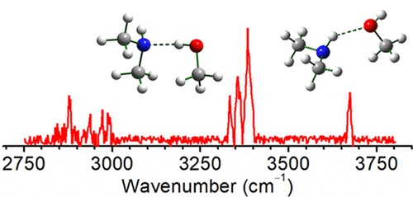
You can also split your content
APPLICATION 3
Detection Of hydrogen Bonding
Intermolecular hydrogen bond:
(hydrogen bond formed between two molecules)
intramolecular hydrogen bond :
(hydrogen bond formed between two different atoms in the same molecular)

Slide 18
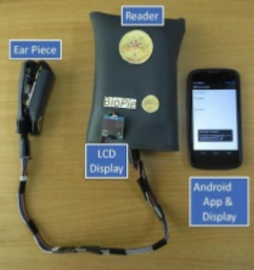
APPLICATION 4
Non-Invasive Blood Glucose Monitoring
Near IR-spectroscopy is used across the ear lobe to measure glucose.
Amount of near Infrared light passing through the ear lobe depends upon Amount of blood glucose in that region

Slide 19
You can also split your content
APPLICATION 5
Forensic Sciences
Analysis of Organic Compounds at the Crime Scene
Identification of Forged or Altered Documents
Detection of Explosives
Examination of Sweat Prints

Slide 20
CONCLUSION
IR spectroscopy vibration modes
Types of IR spectrometer
IR spectrum and its range
Principle
Advantages and limitations
Analysis of artist’s pigments
Detection of impurities in inorganic and organic substances
Non invasive glucose blood monitoring
Industrial applications
Medical applications

Slide 21
ANY QUESTIONS?

Slide 22


